Slide 1
DATA ANALYTICS • DEEP LEARNING • BUSINESS INTELLIGENCE
Deep Learning-Driven
Customer Analytics
Purchase Prediction, Segmentation
& Business Intelligence
CUSTOMERPULSE AI | INTEGRATED ANALYTICS FRAMEWORK
M. Pallavi • G. Divija Medha • Sheri Saswitha
2420030373 | 2420030481 | 2420090067
K L (Deemed to be) University • Data Analytics and Visualization • Batch 9
2026–2027

Slide 2
01 / CONTEXT
The Customer Intelligence Challenge
Customer data is abundant—but turning it into joined-up, predictive decisions is still difficult.
SCATTERED DATA
HIDDEN PATTERNS
SILOED ANALYSIS
DECISION GAP
Demographics, transactions, spending and online-session behaviour often sit in separate datasets.
Descriptive summaries may miss nonlinear relationships between browsing behaviour and purchase outcomes.
Segmentation, spending analysis and purchase prediction are frequently treated as separate tasks.
Teams need clear insights they can use for targeting, engagement and retention.
PROBLEM STATEMENT
How can customer data be integrated to identify meaningful segments, predict purchase outcomes and present useful business intelligence in one workflow?
Project response: combine exploratory analytics, K-Means segmentation, MLP purchase prediction and a dashboard.
02

Slide 3
02 / GOALS
Objectives
Three connected goals turn raw customer information into actionable intelligence.
01 UNDERSTAND
02 PREDICT & SEGMENT
03 SUPPORT DECISIONS
• Profile demographics and spending
• Explore purchasing and browsing patterns
• Engineer useful behavioural features
• Review RFM-style customer activity
• Group customers into four segments
• Predict session-level purchase outcomes
• Evaluate model performance
• Identify customer groups for follow-up
• Present results in ConsumerPulse AI
• Visualize customer and spending patterns
• Surface purchase propensity insights
• Support targeted engagement and marketing
Core idea: segmentation explains *who* customers are; prediction estimates *what they may do next*.
03

Slide 4
03 / RELATED WORK
Literature Survey
Prior work contributes useful techniques, but each approach answers only part of the customer analytics problem.
RESEARCH THEME
WHAT IT CONTRIBUTES
LIMITATION / OPPORTUNITY
Purchase prediction
MLP / neural models learn patterns from shopping-session features.
Prediction alone does not describe customer segments.
RFM & segmentation
Recency, Frequency and Monetary value help group customers by activity.
Segmentation does not directly predict the next purchase.
Explainable AI
LIME and SHAP can help interpret individual and global predictions.
Explanations need to be connected to business workflows.
Business intelligence
Dashboards summarize trends and help teams explore results.
Insights can remain fragmented when analytics are not integrated.
Research direction: combine customer profiling, segmentation, prediction and dashboard-based interpretation.
04

Slide 5
04 / RESEARCH GAP
What the Project Brings Together
The project responds to fragmentation across data, modelling and decision support.
GAP 01
Fragmented analytics
GAP 02
Mixed data types
Spending, customer grouping and purchase prediction are often handled separately.
Demographic, transaction and session features require careful preparation and feature engineering.
GAP 03
Nonlinear behaviour
GAP 04
Business translation
Simple descriptive analysis may not capture complex relationships in shopping sessions.
Model outputs need to be presented in a form that supports practical decisions.
Proposed direction: a shared workflow from customer data → segmentation & prediction → BI dashboard.
05

Slide 6
05 / DATA
Datasets & Preparation
Three complementary dataset types are described in the project documentation.
CONSUMER / RETAIL SPENDING
PREPROCESSING CHECKLIST
4,905 records • 14 features
Customer characteristics and spending patterns
• Inspect schema, data types and missing values
• Remove duplicate records and correct formats
• Encode categorical features where required
• Create browsing, time and spending features
• Explore distributions, relationships and outliers
SYNTHETIC SHOPPING BEHAVIOUR
10,000 records • 12 features
Simulated customer behaviour and preferences
ONLINE SHOPPERS INTENTION
12,330 records • 18 features
Browsing-session behaviour and purchase outcome
Note: dataset names and counts are taken from the supplied documentation; confirm them against the final data files before formal submission.
06

Slide 7
06 / SYSTEM DESIGN
End-to-End System Architecture
A single analytical pipeline connects data preparation, customer grouping, purchase prediction and business interpretation.
01
02
03
04
05
06
DATA INPUT
PREPARE
EXPLORE
SEGMENT
PREDICT
PRESENT
→
→
→
→
→
Spending • profiles
Online sessions
Clean • encode
Feature engineer
EDA • patterns
Feature review
K-Means
4 customer groups
MLP neural network
Purchase / no purchase
ConsumerPulse AI
BI dashboard
OUTPUTS • Customer segments • Purchase propensity • Spending patterns • Business insights
Churn, customer lifetime value, autoencoders and SHAP/LIME are described as additional or future capabilities in the documentation.
07

Slide 8
07 / MODELLING
Purchase Prediction with an MLP
A Multi-Layer Perceptron learns relationships between session behaviour and the purchase outcome.
MODEL CONFIGURATION
CONCEPTUAL NETWORK
Input features
Page views, browsing duration, bounce rate, exit rate, page value, visitor type, weekend activity
Hidden layers
48 neurons → 24 neurons
Activation
ReLU
Optimizer
Adam
Training controls
Maximum iterations: 120 • Random state: 42 • Early stopping
INPUT
48 → 24
OUTPUT
Target: classify a shopping session as purchase or no purchase.
08

Slide 9
08 / CUSTOMER SEGMENTATION
K-Means: Four Customer Groups
Customers are clustered using demographic, spending, satisfaction and loyalty characteristics.
01
HIGH-VALUE / ACTIVE
02
POTENTIAL GROWTH
Higher spending and stronger engagement; nurture loyalty.
Moderate activity; targeted offers may encourage repeat purchases.
03
LOW-ENGAGEMENT
04
AT-RISK / INACTIVE
Lower activity or satisfaction; investigate barriers and improve experience.
Limited engagement; consider retention-oriented outreach.
Segments are conceptual business labels; validate their final meaning against the actual cluster profiles.
09

Slide 10
09 / EVALUATION
Reported Purchase Prediction Results
The research paper reports validation performance for the MLP purchase-intention model.
VALIDATION ACCURACY
ROC–AUC
89.55%
92.34%
Correct classifications on validation data
Reported ability to separate the two classes
Interpretation: the reported scores are promising, but independent testing, class-wise metrics and validation on additional datasets are needed before real-world deployment.
Source: supplied research paper and project documentation. These are reported results, not independently re-run here.
10

Slide 11
10 / BUSINESS INTELLIGENCE
ConsumerPulse AI: From Model Output to Action
The prototype dashboard brings customer profiles, spending patterns, segments and purchase predictions into one view.
CONSUMERPULSE AI / CUSTOMER OVERVIEW
UNDERSTAND
Profile spending and customer behaviour.
CUSTOMERS
SEGMENTS
PREDICTION
12.3K
4
MLP
TARGET
CUSTOMER SEGMENT MIX
PURCHASE PROPENSITY TREND
Tailor campaigns to meaningful segments.
RETAIN
Use engagement signals to guide follow-up.
Illustrative dashboard layout — not a screenshot or measured live output.
Decision support—not a replacement for business judgment.
11

Slide 12
11 / IMPLEMENTATION
Technology Stack & Feasibility
The framework is designed to run on commonly available tools and standard computing hardware.
DATA & ANALYSIS
MODELLING
PRESENTATION
Python
Pandas • NumPy
Matplotlib
CSV / Excel datasets
Scikit-learn
MLP neural network
K-Means clustering
Jupyter / Google Colab
Streamlit dashboard
Interactive visualizations
Customer profiles
Business insights
HARDWARE
Intel Core or equivalent • 8 GB RAM recommended • 10 GB free storage • GPU optional
Open-source libraries and standard hardware make the prototype technically and economically feasible.
12

Slide 13
12 / NEXT STEPS
Limitations & Future Scope
The current project focuses on K-Means segmentation, MLP purchase prediction and dashboard-based insight.
VALIDATE MORE BROADLY
IMPROVE INTERPRETABILITY
Test on independent datasets; document data splits, class balance and additional metrics.
Integrate SHAP/LIME explanations after verifying implementation and model compatibility.
EXPAND MODELLING
EXTEND CUSTOMER VALUE
Explore sequence-based models such as LSTM or transformers where ordered session data is available.
Validate churn prediction, CLV estimation and autoencoder-based analysis as future modules.
Important: these extensions are future directions in the supplied documentation, not claimed as completed results.
13

Slide 14
13 / CONCLUSION
From Customer Data to Better Decisions
An integrated workflow helps connect customer understanding with predictive signals and business action.
UNDERSTAND
SEGMENT
PREDICT
ACT
→
→
→
Customer and spending patterns
Four K-Means customer groups
MLP purchase outcome
Dashboard-supported insights
KEY REPORTED RESULT
REFERENCES / BASIS
89.55% validation accuracy • 92.34% ROC-AUC
• Supplied research paper: Deep Learning-Driven Customer Analytics
• Supplied project documentation, Sections 3–7
• Key related work cited in the report: Sakar et al.; Ribeiro et al.; Lundberg & Lee
Thank you • Questions & Discussion
14

Slide 15
14 / COMPARATIVE ANALYSIS
Deep Learning Models — Performance Comparison
Values transcribed from the comparative-analysis image supplied for this presentation.
CUSTOMER PURCHASE & SEGMENTATION METRICS
Accuracy
F1-score (Macro)
AUC-ROC (Macro)
Silhouette score
1.0
0.901
0.901
0.943
0.936
0.908
0.915
0.912
0.905
0.948
0.873
0.861
0.894
0.893
0.885
0.845
0.868
0.855
0.832
0.8
0.6
0.521
0.412
0.458
0.431
0.467
0.4
0.398
0.2
0.0
MLP
(Multi-Layer Perceptron)
TabNet
(Attention-based)
Wide & Deep
(Hybrid)
Autoencoder
+ K-Means
LSTM
(Sequence)
FT-Transformer
(Tabular Transformer)
Interpretation: FT-Transformer has the highest accuracy and AUC-ROC in the supplied comparison; Autoencoder + K-Means has the highest silhouette score.
15

Slide 16
14 / COMPARATIVE ANALYSIS
Training Efficiency Across Model Families
The source image reports training-performance scores on a 1 − loss scale; higher is better.
TRAINING PERFORMANCE (1 − LOSS)
MLP
(Multi-Layer Perceptron)
0.688
TabNet
(Attention-based)
0.759
Wide & Deep
(Hybrid)
0.732
Autoencoder
+ K-Means
0.615
LSTM
(Sequence)
0.702
FT-Transformer
(Tabular Transformer)
0.772
0.0
0.2
0.4
0.6
0.8
1.0
FT-Transformer (0.772) and TabNet (0.759) lead this reported efficiency comparison. These values are reproduced from the supplied image and were not independently verified.
16

Slide 17
15 / MODEL SELECTION
What the Comparison Suggests
A practical reading of the provided comparison—useful for discussion, not a substitute for controlled benchmarking.
BEST REPORTED CLASSIFICATION METRICS
STRONG ALTERNATIVE
FT-Transformer leads on accuracy (0.912) and AUC-ROC (0.948) in the supplied chart.
TabNet reports 0.901 accuracy, 0.894 macro F1 and 0.943 AUC-ROC.
SEGMENTATION SIGNAL
TRAINING PERFORMANCE
Autoencoder + K-Means has the strongest silhouette score (0.521) among the compared methods.
FT-Transformer (0.772) and TabNet (0.759) are highest on the supplied 1 − loss comparison.
Important: the original project documentation reports MLP validation accuracy of 89.55% and ROC-AUC of 92.34%. The new chart contains a separate model comparison supplied as an image; keep the two result sources distinct.
For a fair comparison, verify identical datasets, splits, preprocessing, evaluation metrics and hardware conditions.
17

Slide 18
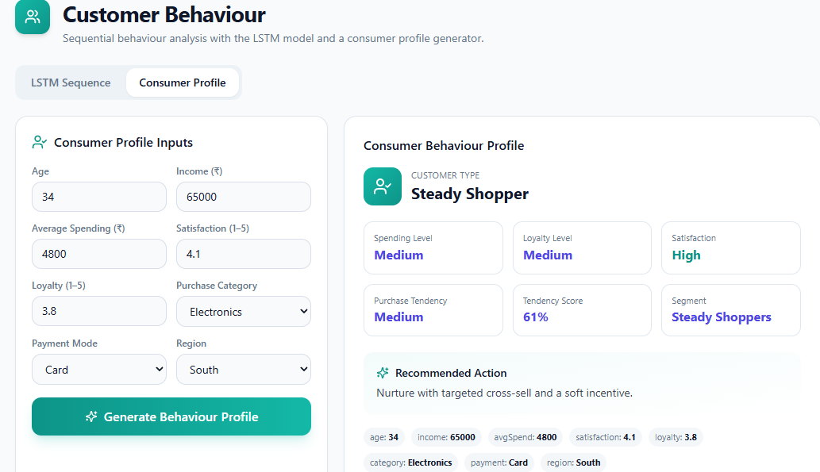
16 / RESULTS
Result 1 — Consumer Behaviour Profile
Consumer profile generator output using demographic, spending, satisfaction and loyalty inputs.
Observed example: “Steady Shopper” profile; medium spending and loyalty, high satisfaction, and 61% purchase tendency. Example output shown in the supplied screenshot.
18

Slide 19
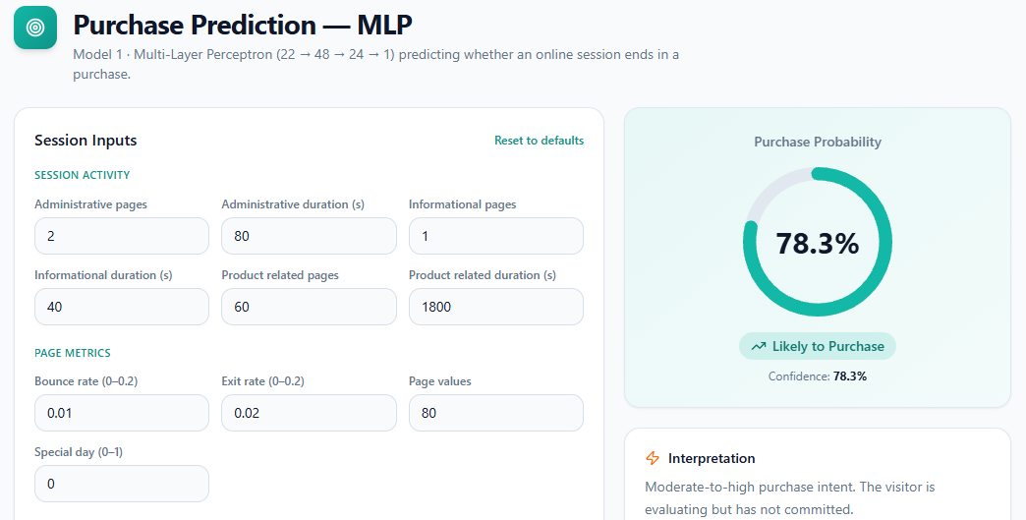
16 / RESULTS
Result 2 — MLP Purchase Prediction
Online-session input features are converted into a predicted purchase probability.
Displayed example: 78.3% purchase probability, labelled “Likely to Purchase”; this is the prediction shown in the screenshot, not a general model metric.
19

Slide 20
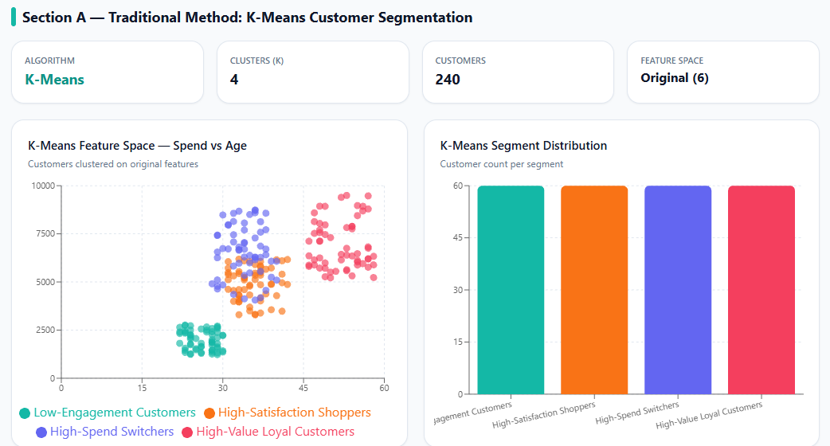
16 / RESULTS
Result 3 — K-Means Customer Segmentation
Four customer clusters visualized with a spend-versus-age feature space and segment counts.
Displayed setup: K-Means with K = 4 and 240 customers; the screenshot shows four named segments and their visual distribution.
20

Slide 21
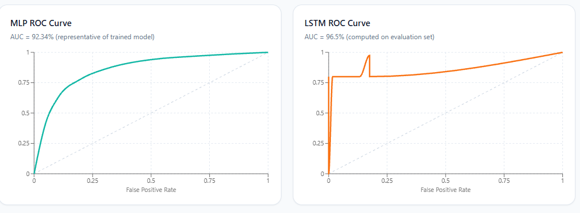
16 / RESULTS
Result 4 — MLP and LSTM ROC Curves
ROC curves compare true-positive and false-positive rates for the two purchase prediction models.
The screenshot labels MLP AUC = 92.34% and LSTM AUC = 96.5%; these are reproduced as displayed and have not been independently verified here.
21

Slide 22
16 / RESULTS
Results Summary — What the Prototype Demonstrates
The supplied screenshots illustrate four different outputs from the customer analytics application.
CUSTOMER PROFILING
PURCHASE PREDICTION
A consumer behaviour profile is generated from age, income, spending, satisfaction, loyalty, category, payment mode and region.
The MLP screen shows a 78.3% purchase probability for the displayed example session.
CUSTOMER SEGMENTATION
MODEL EVALUATION
K-Means groups 240 displayed customers into four segments for exploratory comparison.
ROC plots display MLP AUC 92.34% and LSTM AUC 96.5%, as labelled in the provided screenshot.
Note: These are screenshot-based example outputs. They should not be interpreted as independently reproduced experiments or as proof that all models were evaluated on the same dataset and split.
Presentation result section: Consumer Behaviour Profile • MLP Prediction • K-Means Segmentation • ROC Analysis
22

